Slide 1

India Telecom Data Analysis
Kovvuru Gurunath Reddy
H316

Slide 2
Introduction
India’s telecom sector serves over a billion subscribers, generating massive relational data daily.
Efficient data storage and analysis are essential for:
• Network performance improvement.
• Customer retention & satisfaction.
• Data-driven strategic decision-making.
This project uses SQL to organize and analyze telecom datasets effectively.

Slide 3
Objective
1. Design a structured and normalized SQL database for telecom operations.
2. Enable advanced analytical queries for real-world insights.
3. Enhance reporting and decision-making efficiency.
4. Support business optimization through data-driven analytics.

Slide 4
Problem Statement
Telecom providers manage huge relational datasets: customers, plans, usage, payments, and support.
Challenges:
• Manual data analysis is slow and error-prone.
• Hard to track active users or popular plans.
• Fragmented and unstructured data.
Solution: Build a normalized SQL schema with efficient relationships and advanced queries for real-time telecom analytics.

Slide 5
Database Tables Overview
Customers – CustomerID, Name, Phone, City, Join Date
Plans – Plan ID, Plan Name, Validity, Price, Data Limit
Subscriptions – Subscription ID, CustomerID, Plan ID, StartDate, End Date
Usage – Usage ID, CustomerID, Date, Calls, SMS, Data Used
Payments – Payment ID, CustomerID, Plan ID, Date, Amount, Method
Customer Support – Support ID, CustomerID, Request Date, Query Type, Status

Slide 6
Analysis and Findings
Network Optimization:
High usage periods and cities with more calls/SMS can be targeted for infrastructure upgrades.
Churn Risk:
Detection of inactive subscriptions or customers with frequent unresolved support queries highlights churn risks.
Plan Performance:
Value and Premium plans have higher revenue but the Basic plan caters to the most users.
Customer Satisfaction:
Faster resolution of support tickets correlates with customer retention and repeat payments.
Business Strategy:
Combining usage, payment, and support analysis enables data-driven pricing, customer engagement, and improved business processes.

Slide 7
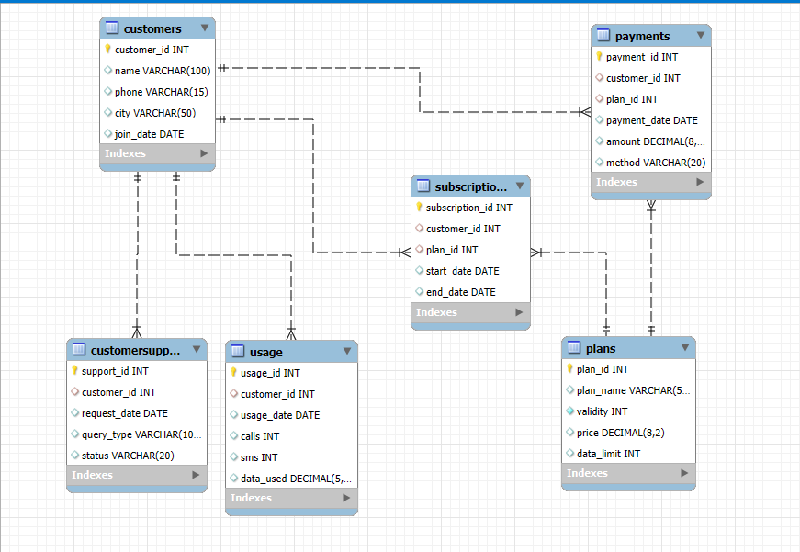
ER Diagram

Slide 8
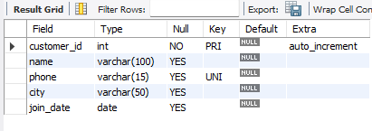
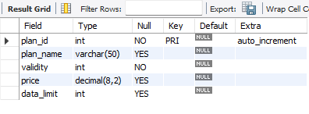
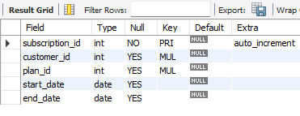
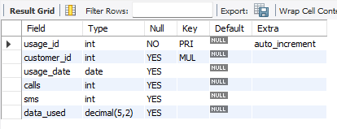
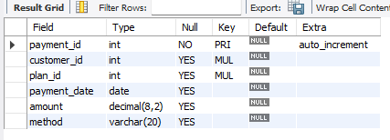
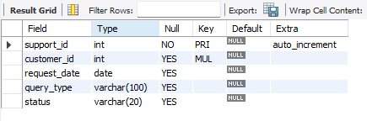
1. Customers Table
Tables in My Database
2. Plans Table
3. Subscriptions Table
4. Usage Table
5. Payments Table
6. Customer Support Table

Slide 9
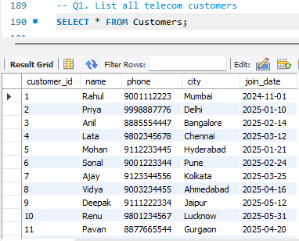
List all telecom customers

Slide 10
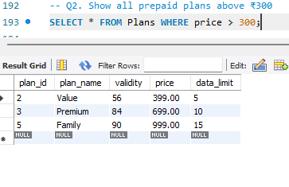
Show all prepaid plans above ₹300

Slide 11
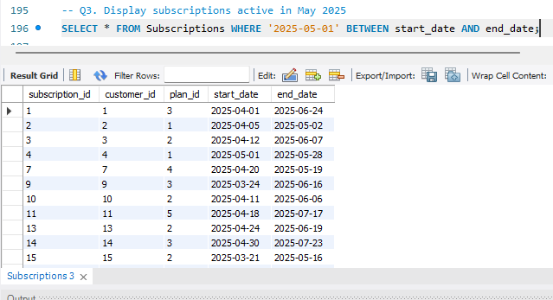
Display Subscriptions Active in May 2025

Slide 12
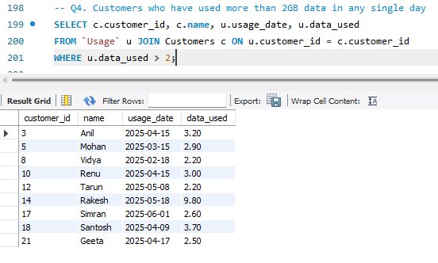
Customers who have used more than 2GB data in any single day

Slide 13
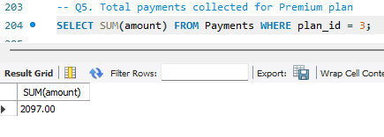
Total Payments Collected For Premium Plan

Slide 14
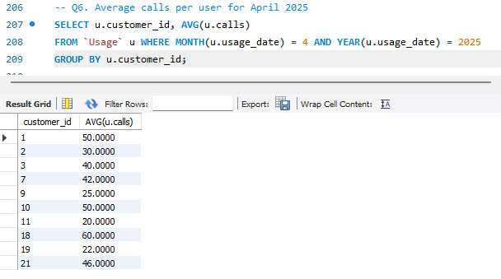
Average calls per user for April 2025

Slide 15
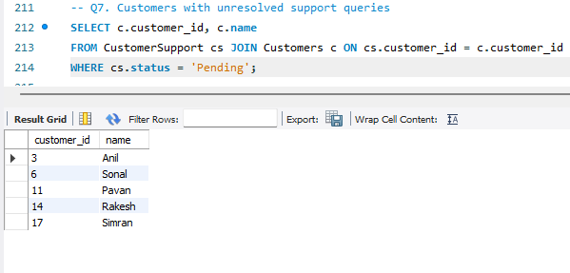
Customers With Unresolved Support Queries

Slide 16
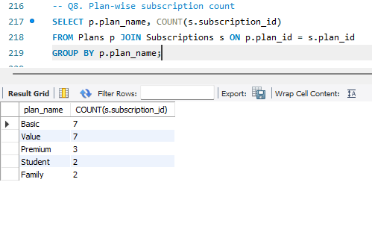
Plan-wise Subscription Count

Slide 17
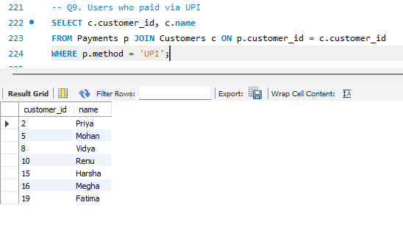
Users who paid via UPI

Slide 18
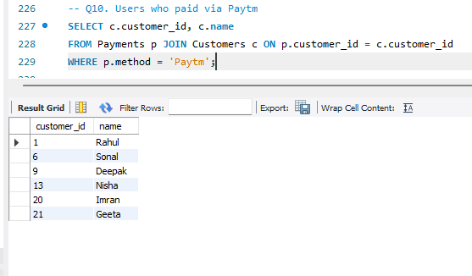
Users who paid via PAYTM

Slide 19
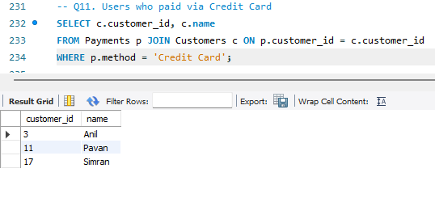
Users who paid via Credit Card

Slide 20
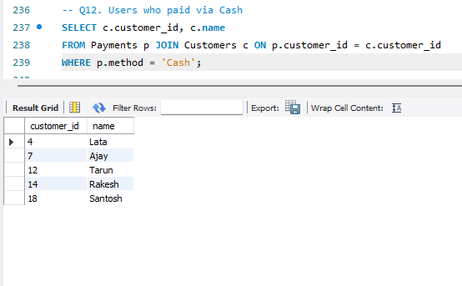
Users who paid via Cash

Slide 21
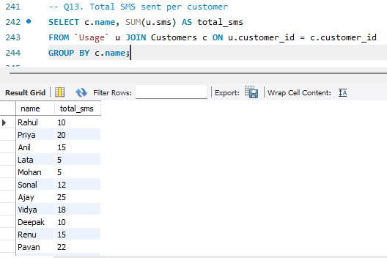
Total SMS Sent per Customer

Slide 22
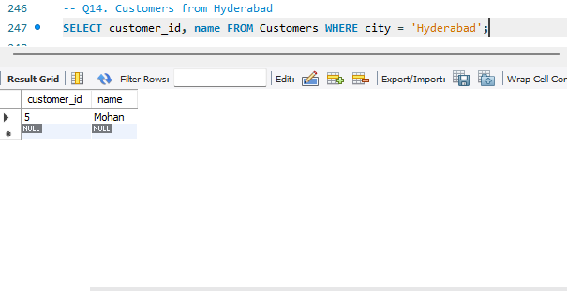
Customers from Hyderabad

Slide 23
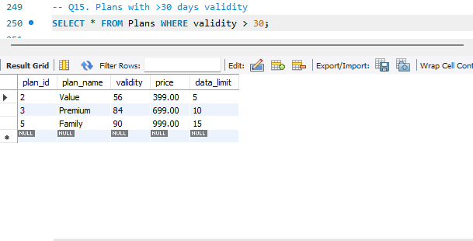
Plans with >30 days validity

Slide 24
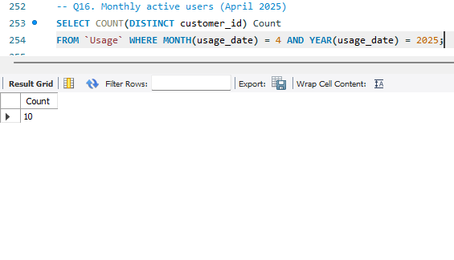
Monthly active users (April 2025)

Slide 25
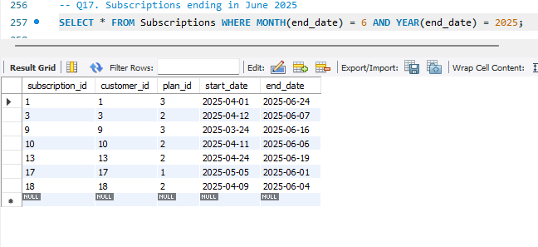
Monthly active user Subscriptions ending in June 2025s (April 2025)

Slide 26
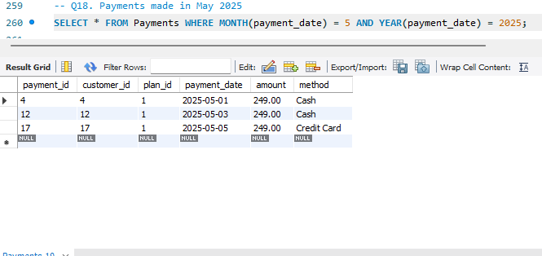
Payments made in May 2025

Slide 27
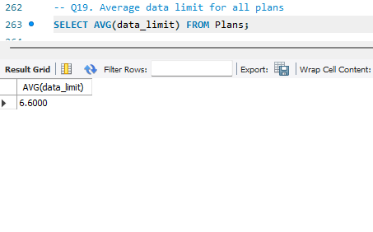
Average data limit for all plans

Slide 28
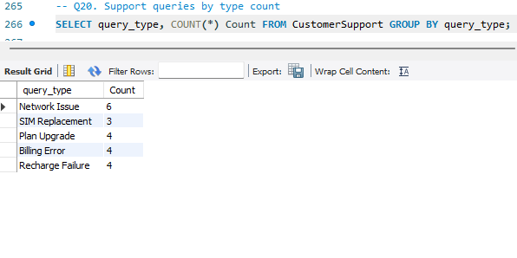
Support queries by type count

Slide 29
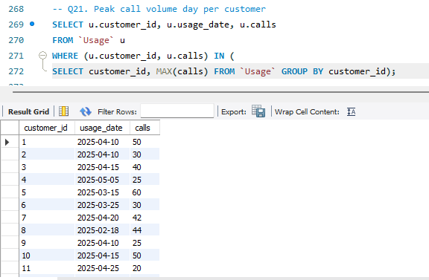
Peak Call Volume Day Per Customer

Slide 30
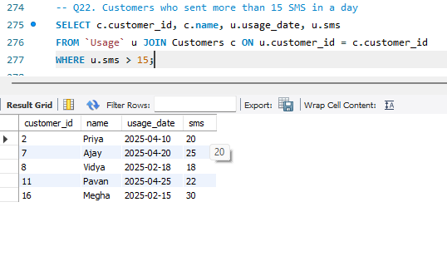
Customers who sent more than 15 SMS in a day

Slide 31
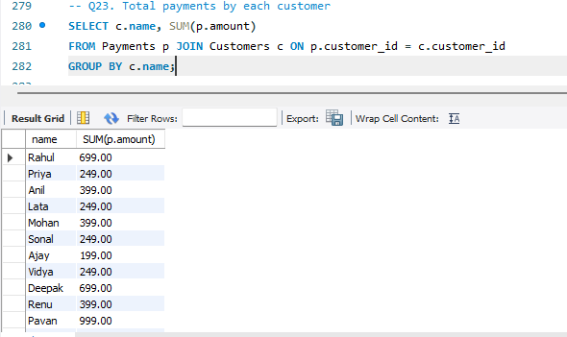
Total payments by each customer

Slide 32
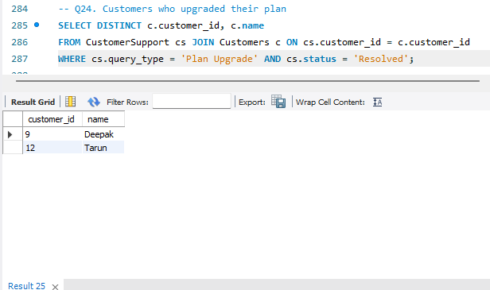
Customers who Upgraded their Plan

Slide 33
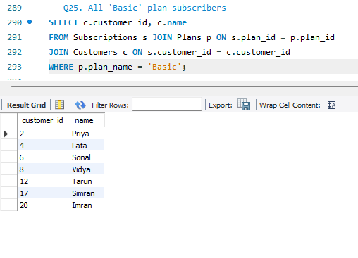
All 'Basic' plan subscribers

Slide 34
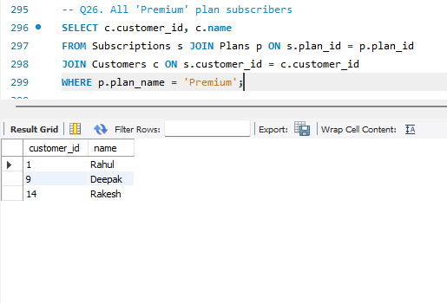
All 'Premium' plan subscribers

Slide 35
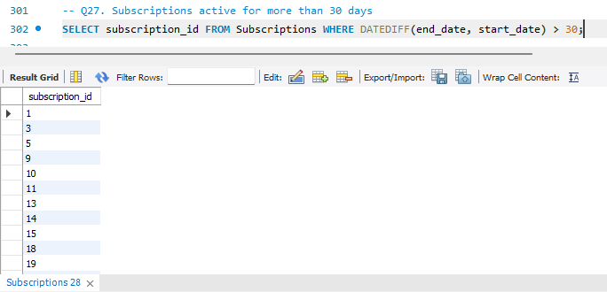
Subscriptions active for more than 30 days

Slide 36
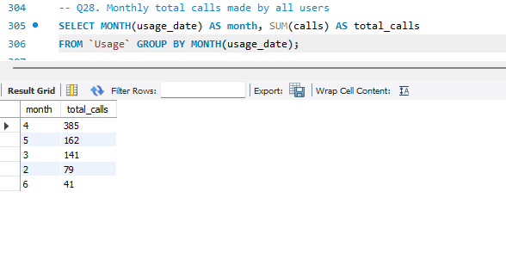
Monthly total calls made by all users

Slide 37
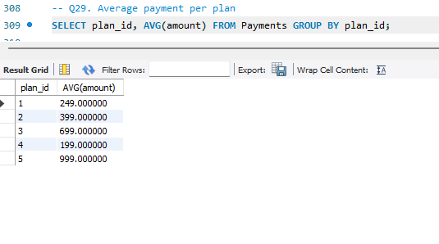
Average payment per plan

Slide 38
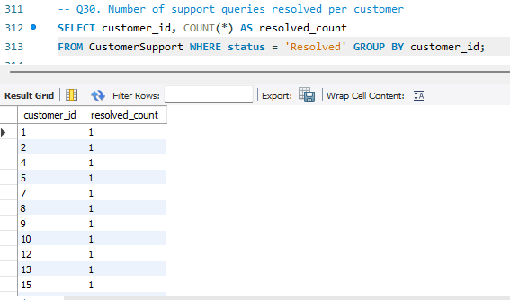
Number of support queries resolved per customer

Slide 39
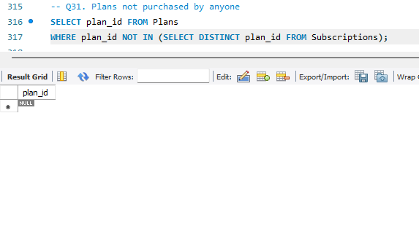
Plans not purchased by anyone

Slide 40
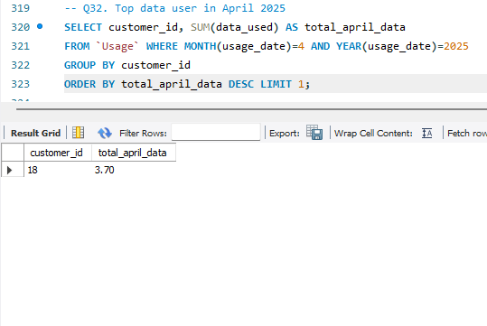
Top data user in April 2025

Slide 41
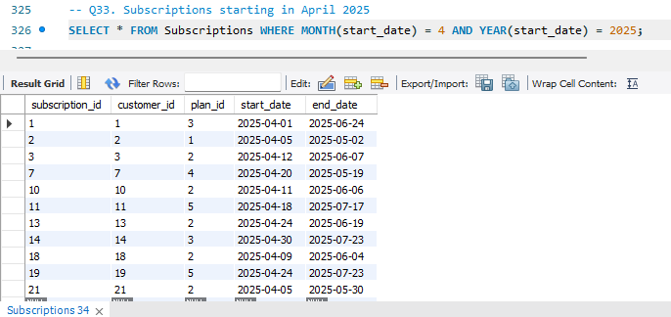
Subscriptions starting in April 2025

Slide 42
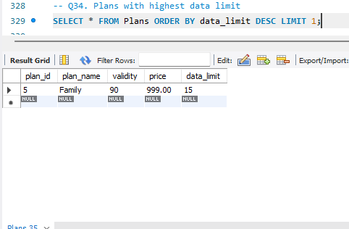
Plans with highest data limit

Slide 43
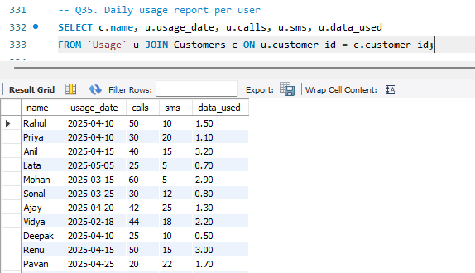
Daily usage report per user

Slide 44
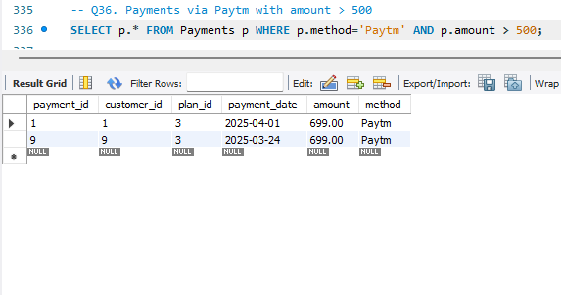
Payments via Paytm with amount > 500

Slide 45
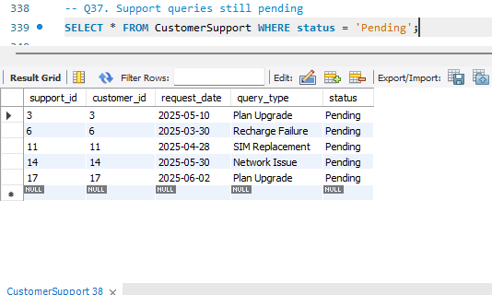
Support queries still pending

Slide 46
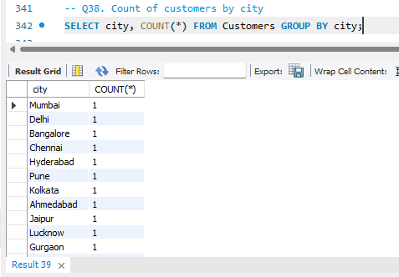
Count of customers by city

Slide 47
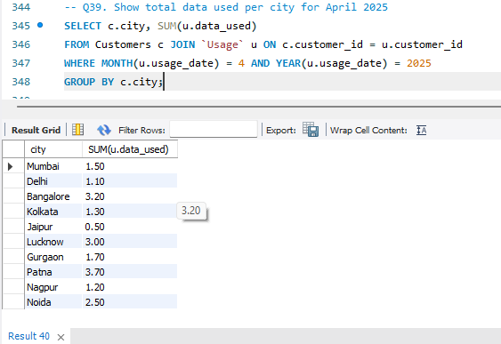
Show total data used per city for April 2025

Slide 48
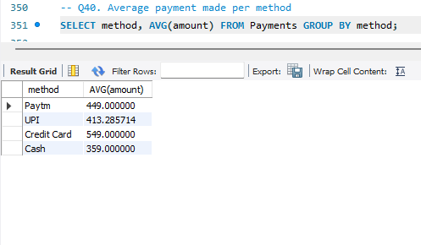
Average payment made per method

Slide 49
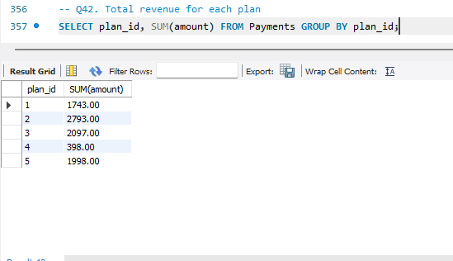
Total revenue for each plan

Slide 50
Summary
Customer Trends:
The data reveals which cities or customer segments are most active, allowing targeted marketing or support.
Plan Popularity:
Analysis shows which plans are most subscribed, informing future product offerings and promotions.
Usage Patterns:
Hourly, daily, and monthly data usage, call, and SMS trends help in network planning and optimizing resources.
Revenue Streams:
Payments data pinpoints the most profitable plans and preferred payment methods among users.
Customer Support:
Query resolution rates and common support types provide insight into customer experience and recurring issues.

Slide 51
Conclusion
A well-designed SQL-based telecom database enables:
• Streamlined operations
• Real-time business insights
• Enhanced reporting & analytics
• Improved customer satisfaction
This project showcases SQL proficiency, database design, and real-world telecom solutions.

Slide 52


